Slide 1
Trusts Law
Week 7: Constitution of Trusts, Volunteers, and Imperfect Gifts
Dr Lukas Simkus

Slide 2

Thematic positioning
Previously:
Three certainties and formalities
This week:
Constitution requirement for trusts

Slide 3

Starting points
Gratuitous promises are unenforceable
Promised gifts where no property is transferred are incomplete
Incomplete gifts are unenforceable
Trusts are a species of gift (see Milroy v Lord)
Trusts where the property has not been transferred to the trustee remain incomplete
Incomplete trusts are unenforceable

Slide 4
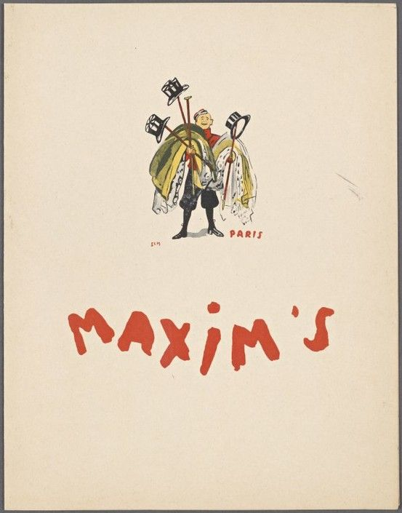
Equitable maxims
‘Equity will not assist a volunteer.’
‘Equity will not perfect an imperfect gift.’
Note: In stark contrast to gifts,
some trusts do not require a transfer of property at all.

Slide 5
Enforceability of promises
General rule in law: a promise is only enforceable when supported by consideration
A volunteer is a recipient or intended recipient of a gift- i.e. someone who has given no consideration
When a donor attempts to gift an asset to a volunteer, but fails to transfer legal title successfully, the attempted transaction is an imperfect gift
When there is an imperfect gift, the volunteer has no recourse at law

Slide 6
Effects of constitution
For a trust to be enforceable, legal title to the trust property must be vested in the trustee in their capacity as trustee
i.e. the trust must be constituted
If a settlor declares themselves a trustee, there is no need to transfer legal title - the declaration of trust will constitute it
If the creation of the trust involves transferring the trust property to trustees other than the settlor, the trust will only be constituted if legal title is successfully transferred to the trustees
An unconstituted trust has no legal effect

Slide 7
Constitution and the two types of express trust
Constitution
Formalities on constitution
1)
S
Transfers property to
T
Formalities on declaration of trust
B
2)
S
T
No separate step of constitution required, as property does not move
Self declaration as
B

Slide 8
Incompletely constituted trusts
When the creation of a trust involves transfer of the trust property to trustees, it is necessary to for legal title to be transferred to the trustees, which is similar to the transfer of legal title from donor to donee of a gift
Where trusts are principally ‘gifts’ in that the beneficiaries (and trustees) are volunteers, the same logic applies - equity will not assist volunteers
Thus, if a trust is not properly constituted, the beneficiary cannot rely on equity’s assistance

Slide 9
The rule in Milroy v Lord (1862) 4 De G,F & J 264
The settlor attempted to transfer some shares in the Bank of Louisiana to Lord to hold on trust for Milroy
The settlor executed the share transfer documentation but did not deposit the necessary documentation with the bank (as was required by the bank’s articles)
No valid trust
The donor/settlor must do everything necessary to effectuate the transfer (this rule is sometimes called the ‘bright line’)
If this is not done, equity will not assist

Slide 10
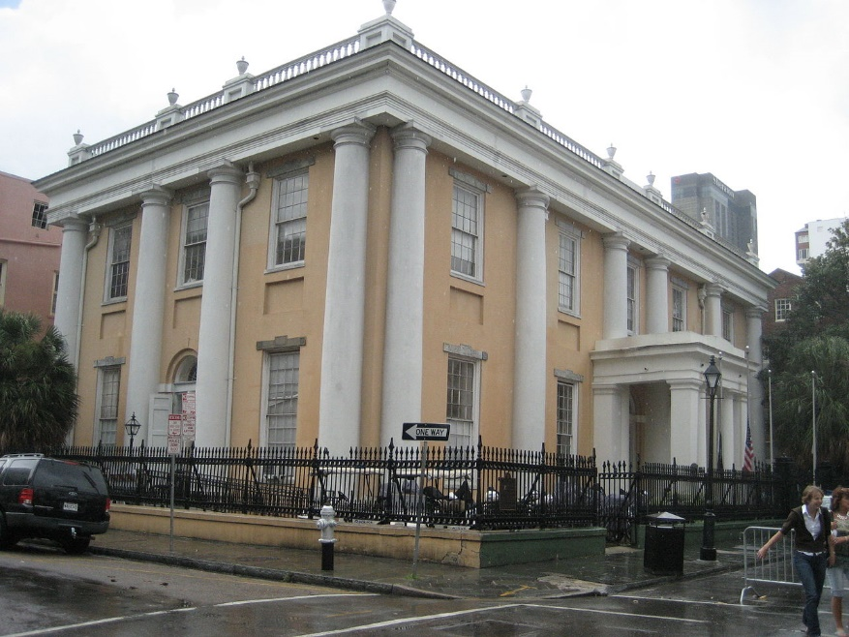
The ‘bright-line’ rule
Turner LJ in Milroy v Lord (1862) 4 De GF & J 264, at 274/1189:
“I take the law of this Court to be well settled, that, in order to render a voluntary settlement valid and effectual, the settlor must have done everything which, according to the nature of the property comprised in the settlement, was necessary to be done in order to transfer the property and render the settlement binding upon him.”

Slide 11
Weird transfers of legal title
Transferring legal title is usually straightforward: delivery + intention + acceptance
But some kinds of property are harder to transfer- e.g:
  Land (deed + registration)
  Shares
    Stock transfer form signed and delivered to transferee
    Share certificates delivered to transferee
    Stock transfer form and certificates delivered by transferee to company
    Acceptance by the company of the transfer, and registration
    S 53(1)(c) LPA 1925, if shares already held by someone else

Slide 12
The rule in Re Rose [1952] Ch 499
Rose attempted to transfer some shares in March. He:
  Executed the share transfer forms
  Delivered the relevant documentation to the company
The directors completed the transfer in June
Rose died four years later
If the shares had been transferred in June, the shares were part of his estate for property (now inheritance) tax purposes
If the shares had been transferred in March, the shares were not part of his estate for inheritance tax purposes
Equity considered the transfers completed in March - this is when Rose had done everything within his power to effectuate the transfer
This rule was applied to registered land in Mascall v Mascall (1985) 49 P & CR 119

Slide 13
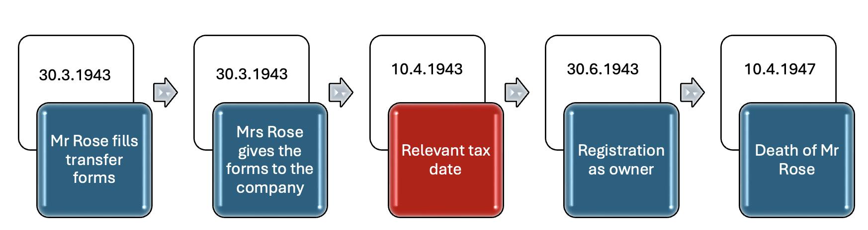
Re Rose: doing everything in one’s power

Slide 14
T. Choithram International SA v Pagarani [2001] 1 WLR 1: Equity ‘will not strive officiously to defeat a gift’
Mr Pagarani executed a deed creating a charitable trust foundation
He then stated that all of his wealth, including his shares, should belong to the foundation
He was one of several trustees of the foundation
After his death, his family claimed that he had not successfully transferred any shares to the foundation:
  He had not formally transferred the shares
  He had not declared himself trustee of the shares
HELD: the trust was constituted by his declaration
Think about whether you agree with this decision

Slide 15
Unconscionability: Pennington v Waine (no 1) [2002] EWCA Civ 227
Ada Crampton wished to transfer shares to Harold
She signed the share transfer form and instructed her accountant, Pennington, to take the necessary steps to complete the transfer
At her death, Pennington had not done this
Harold claimed the shares:
  He could not rely on Re Rose - Ada had not done everything with her power (due to her agent’s failings)
  He succeeded because revocation by Ada would have been unconscionable

Slide 16
Established Exceptions to Milroy v Lord: The Rule in Strong v Bird
When a donor makes an imperfect gift to a donee or a trustee who is then appointed executor or administrator of the donor’s estate…
… the vesting in the donee or trustee, in their capacity as executor or administrator, of legal title to the gift is regarded by equity as having perfected the gift…
so long as the following requirements are satisfied:
  an attempt to make immediate inter vivos gift of specific property;
  a continuing intention on the part of the donor to make the gift, and this intention must persist until the donor’s death;
  legal title to the subject matter of the gift must be vested in the donee after the death of the donor as his capacity as executor/administrator of the donor’s estate
E.g. Re James [1935] Ch 449

Slide 17
Established Exceptions to Milroy v Lord: Donationes Mortis Causa
A donatio mortis causa (DMC) is a gift recognised by equity that is made in contemplation of death
It is conditional upon death and only takes effect on the donor’s death
When a DMC is successful, equitable title to the subject matter of the DMC passes to the donee/trustee upon the donor/settlor’s death
DMCs are not testamentary dispositions, so are not regulated by the Wills Act
A DMC is not a conveyance of legal title to land, so the Law of Property Act 1925, s52(1), which requires conveyances of legal title to be by deed, does not apply to DMCs of land.
53(1)(b), which requires trusts of land to be evidenced in writing: DMCs are given effect by constructive trust (s53(2)

Slide 18
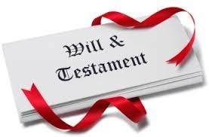
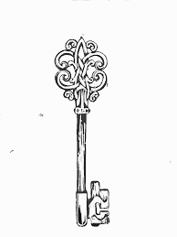

Donatio mortis causa (deathbed gift)
Life of the testator
Will
DMC
Death
Property not contained
in the will
Contemplation of death
Delivery of property or
‘indicia of title’
Revocability
Death constitutes
the gift

Slide 19
Established Exceptions to the Rule in Milroy v Lord: Donationes Mortis Causa
The requirements for DMCs are (Cain v Moon [1896] 2 QB 283):
  The gift must be made in contemplation, though not necessarily in expectation, of death
  The subject matter of the DMC must be delivered (physically or symbolically) to the donee
  The gift must be conditional up on death
E.g. Sen v Headley [1991] Ch 425

Slide 20
Recap
Constitution is a vital step in creating a valid trust.
It is needed for trusts with separate trustees, but not for self-declaration trusts.
Various exceptions allow settlors/testators to settle property on trust even though the trust has not been fully constituted.

